Slide 1
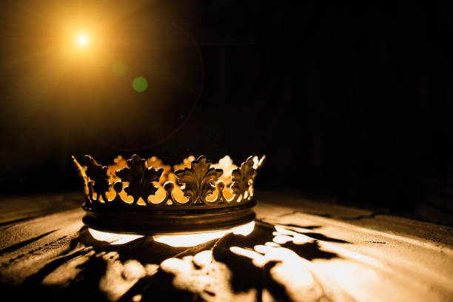
HEBREWS

Slide 2
“Jesus – The Better Adam”
Hebrews 2:5-9

Slide 3
The Failure of the First Adam - (verses 5-8)

Slide 4
Genesis 1:27-28
“27 So God created man in his own image, in the image of God he created him; male and female he created them. 28 And God blessed them. And God said to them, ‘Be fruitful and multiply and fill the earth and subdue it, and have dominion over the fish of the sea and over the birds of the heavens and over every living thing that moves on the earth.’”

Slide 6
“People were made to be the master of the natural world... Yet this is not a perfect kingdom that we see in the natural world. Man does not yet rule the world. Wild beasts defy him. Storms vanquish him. There are a thousand things not at present submissive to his control.” C.H. Spurgeon

Slide 8
Genesis 2:17
“but of the tree of the knowledge of good and evil you shall not eat, for in the day that you eat of it you shall surely die.”

Slide 9
Romans 8:22-23
“22 For we know that the whole creation has been groaning together in the pains of childbirth until now. 23 And not only the creation, but we ourselves, who have the firstfruits of the Spirit, groan inwardly as we wait eagerly for adoption as sons, the redemption of our bodies.”

Slide 11
II. The Success of the Second Adam - (verse 9)

Slide 12
Philippians 2:5-8
“5 Have this mind among yourselves, which is yours in Christ Jesus, 6 who, though he was in the form of God, did not count equality with God a thing to be grasped, 7 but emptied himself, by taking the form of a servant, being born in the likeness of men. 8 And being found in human form, he humbled himself by becoming obedient to the point of death, even death on a cross.”

Slide 13
“The First and Second Adam”
By Isaac Watts
Adam, our father and our head,
Transgressed, and justice doomed us dead;
The fiery law speaks all despair:
There's no reprieve nor pardon there.
But, O unutterable grace
The Son of God takes Adam's place;
Down to our world the Savior flies,
Stretches his arms, and bleeds, and dies.

Slide 15
“The first Adam plunged humanity into sin and death; the last Adam plunged into death for the sake of humanity.” Al Mohler

Slide 16
Romans 5:17
“For if, because of one man’s trespass, death reigned through that one man, much more will those who receive the abundance of grace and the free gift of righteousness reign in life through the one man Jesus Christ.”
1 Corinthians 15:22
“For as in Adam all die, so also in Christ shall all be made alive.”

Slide 18
“Crown Him With Many Crowns”
Crown Him with many crowns
The Lamb upon His throne;
Hark! How the heavenly anthem drowns
All music but its own:
Awake, my soul, and sing
Of Him who died for thee,
And hail Him as thy matchless King
Through all eternity.

Slide 19
“Crown Him With Many Crowns”
Crown Him the lord of life,
Who triumphed o’er the grave,
And rose victorious in the strife
For those He came to save;
His glories now we sing
Who died, and rose on high.
Who died, eternal life to bring
And lives that death may die.

Slide 21
“Think of this the next time you are on the dunghill of self-loathing. See Jesus, and know that as He is, so are you also before the infinite Majesty. You are not condemned for He is enthroned. You are not despised nor abhorred, for He is beloved and exalted. You are not in jeopardy of perishing, nor in danger of being cast away, for He dwells eternally at the right hand of the Lord Almighty. What a vision is this for you, when you see Jesus, and see yourself complete in Him, perfect in Christ Jesus!” C.H. Spurgeon

Slide 23
“There is amazement at the discovery of so stupendous love to man. How He emptied Himself for sinners! This work of Christ is the greatest wonder and astonishment even to the angels.” Matthew Poole

Slide 24
“Come Behold the Wondrous Mystery”
In our longing, in our darkness
Now the light of life has come
Look to Christ, who condescended
Took on flesh to ransom us
Come behold the wondrous mystery
He the perfect Son of Man
In His living, in His suffering
Never trace nor stain of sin

Slide 25
“Come Behold the Wondrous Mystery”
See the true and better Adam
Come to save the hell-bound man
Christ the great and sure fulfillment
Of the law; in Him we stand
Come behold the wondrous mystery
Christ the Lord upon the tree
In the stead of ruined sinners
Hangs the Lamb in victory

Slide 26
“Come Behold the Wondrous Mystery”
See the price of our redemption
See the Father’s plan unfold
Bringing many sons to glory
Grace unmeasured, love untold

