Slide 1
Our Aim
(1 Timothy 1:3-7)

Slide 2
In I Timothy 1:5 we find two things about Our Aim.
2
I. Its Identification
II. Its Qualities

Slide 3

I. Its Identification
A. The Charge
Paul an apostle of Christ Jesus by command of God… (v. 1)
Charge certain persons… (v. 3)
The aim of our charge… (v. 5)

Slide 4
Paul’s Conversion and Commissioning
Acts 26:16-18
16 But rise and ^{m}stand upon your feet, for I have appeared to you for this purpose, ^{n}to appoint you as a servant and witness to the things in which you have seen me and to those in which I will appear to you, 17 ºdelivering you from your people and from the Gentiles—^{p}to whom I ^{q}am sending you 18 ^{r}to open their eyes, so that they may turn from darkness to light and from ^{s}the power of Satan to God, that they may receive ^{t}forgiveness of sins and ^{u}a place among those who are sanctified ^{v}by faith in me.’

Slide 5
Timothy’s Charge
5
1 Timothy 1:18-19a
This charge I entrust to you, Timothy, my child, in accordance with the prophecies previously made about you, that by them you may wage the good warfare, holding faith and a good conscience.

Slide 6

C. The Aim: The aim of our charge is love…(v. 5).
1 Corinthians 13:1-4
1 If I speak in the tongues of men and of angels, but have not love, I am a noisy gong or a clanging cymbal. 2 And if I have ªprophetic powers, and understand all mysteries and all knowledge, and if I have all faith, ^{b}so as to remove mountains, but have not love, I am nothing. 3 ^{c}If I give away all I have, and ^{d}if I deliver up my body to be burned,¹ but have not love, I gain nothing.4 ^{e}Love is patient and ^{f}kind; love ^{g}does not envy or boast; it ^{h}is not arrogant 5 or rude. It ^{i}does not insist on its own way; it ^{j}is not irritable or resentful;² 6 it ^{k}does not rejoice at wrongdoing, but ^{l}rejoices with the truth. 7 ^{m}Love bears all things, believes all things, hopes all things, ^{e}endures all things. 8 Love never ends.…13 So now faith, hope, and love abide, these three, but the greatest of these is love.

Slide 7
John 13:34-35
34 ^{t}A new commandment ^{u}I give to you, ^{v}that you love one another: ^{w}just as I have loved you, you also are to love one another. 35 ^{x}By this all people will know that you are my disciples, if you have love for one another.”

Slide 8
Galatians 5:6
For in Christ Jesus ^{e}neither circumcision nor uncircumcision counts for anything, but ^{f}only faith working through love.

Slide 9

II. Its Qualities
A. Pure Heart
The heart is the center and and source of mental and moral activity.

Slide 10
Jesus’ transfiguration – his face shone like the sun, and his clothes became white as light (Mt. 17:2).
David prayed, Create in me clean heart, O God (Ps. 51:10)
Peter described it as ^{x}having cleansed their hearts ^{y}by faith (Acts 15:9)
Jesus cleanses His Church by the washing of water by the word concluding that she might be holy and without blemish (Eph. 5:26, 27c)
Blessed are the pure in heart for they shall see God (Mt. 5:8).

Slide 11
How do we keep a pure heart pure?
1 John 1:7-9. 7
But ^{p}if we walk in the light, ^{q}as he is in the light, we have fellowship with one another, and ^{r}the blood of Jesus his Son cleanses us from all sin. 8 ^{s}If we say we have no sin, we deceive ourselves, and ^{t}the truth is not in us. 9 ^{u}If we confess our sins, he is ^{v}faithful and just to forgive us our sins and ^{r}to cleanse us from all unrighteousness.

Slide 12
Paul tells Timothy, if anyone cleanses himself from what is dishonorable, he will be a vessel for honorable use, set apart as holy, useful to the master of the house, ready for every good work (2 Tim. 2:21).

Slide 13

Good Conscience
Romans 2:14-16
14 For when Gentiles, who do not have the law, ^{x}by nature do what the law requires, they are a law to themselves, even though they do not have the law. 15 They show that the work of the law is ^{y}written on their hearts, while their conscience also bears witness, and their conflicting thoughts accuse or even excuse them 16 ^{z}on that day when, ªaccording to my gospel, God judges ^{b}the secrets of men ^{c}by Christ Jesus.

Slide 14
He wrote, …by open statement of the truth we would commend ourselves to everyone’s conscience in the sight of God (2 Cor. 4:2b).
The writer of Hebrews puts it this way, how much more will the blood of Christ, who through the eternal Spirit offered himself without blemish to God, purify our conscience from dead works to serve the living God (9:14).
9 ^{u}If we confess our sins, he is ^{v}faithful and just to forgive us our sins and ^{r}to cleanse us from all unrighteousness (1 Jn. 1:9)

Slide 15

Romans 12:2 says, it so very well. ^{c}Do not be conformed to this world,³ but be transformed by ^{d}the renewal of your mind, that by testing you may ^{e}discern what is the will of God, what is good and acceptable and perfect.

Slide 16
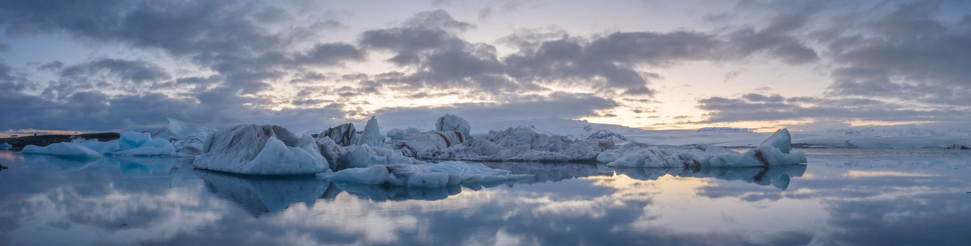
Verse 4 of our text, the stewardship of God that is by faith.
For whatever does not proceed from faith is sin (Rom. 14:23)
Paul exhorted, For we walk by faith not by sight (2 Cor. 5:7)
I believe; help me in my unbelief (Mk. 9:24)

