Slide 1
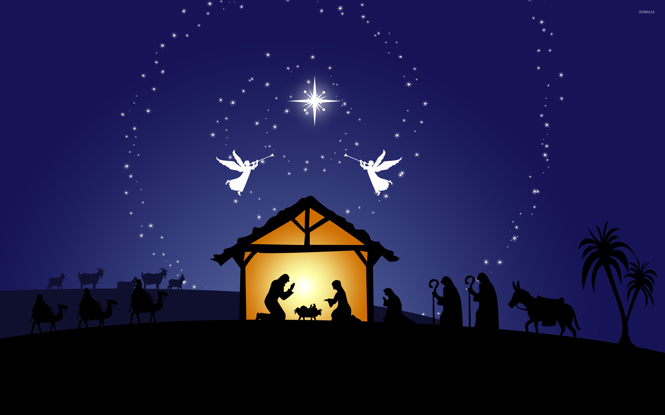
“When God Draws Near to the Weary”
Today’s Texts: Matthew 1:23; Isaiah 9:2; John 14:1-3

Slide 2
God Draws Near in Our Weakness
(Matthew 1:23)
2. God Draws Near to Keep His Promises
(Isaiah 9:2)
3. God Draws Near to Bring Us Home
(John 14:1-3)

