Slide 1
The Injustice of this Life
Matthew 14:1-12
Pastor Sam
January 14, 2023

Slide 2


Scripture Reading
The Injustice of this Life
Matthew 14:1-12

Slide 3
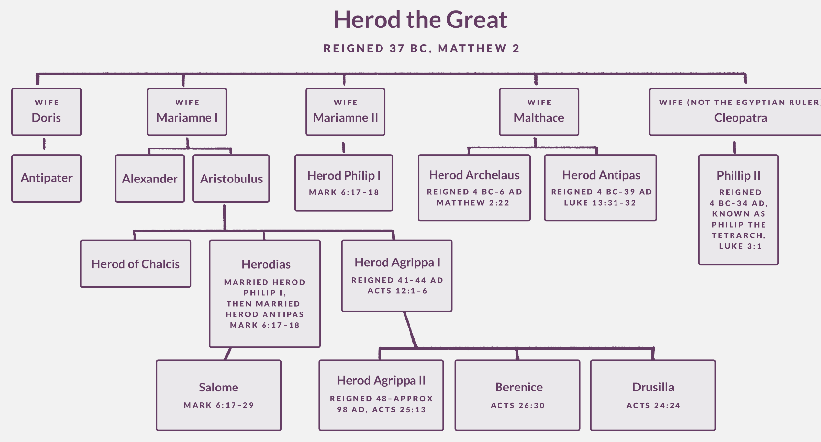

Slide 4
Disciples need to be prepared for….
Rejection, persecution, even death
Counting the cost of following Jesus
Trusting in God’s sovereignty

Slide 5
To God be the glory!

