Slide 1
Compassion & Judgment on the Lost
Matthew 14:34-15:9
Pastor Sam
February 4, 2023

Slide 2


Scripture Reading
Compassion & Judgment on the Lost
Matthew 14:34-15:9

Slide 3

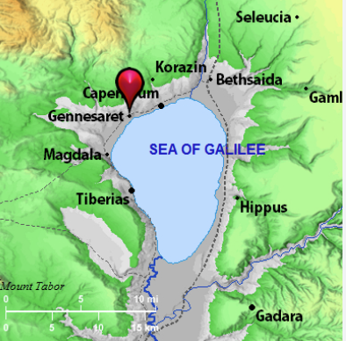



Matt. 15:34
When they had crossed over, they came to the land of Gennesaret.

Slide 4
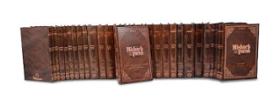
Mishna & Talmud in English –
18 Volume Set - $770 (Amazon)

Slide 5
Application
Have compassion and be generous to the lowly & needy and share the gospel with them.
Prioritize the Word of God over the traditions of man.

Slide 6
To God be the glory!

