Slide 1
Good Friday Service
Genesis 15, Isaiah 53, Galatians 3
Pastor Sam
March 29, 2024

Slide 2
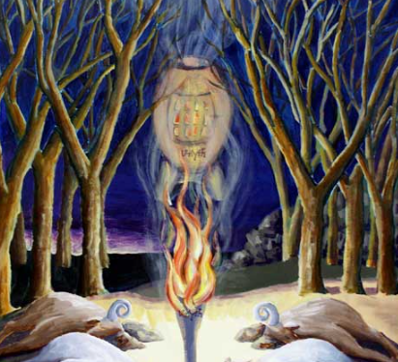
God’s
Covenant
With
Abraham
Genesis 15

Slide 3

Isaiah 53 & Galatians 3:13-14

Slide 4

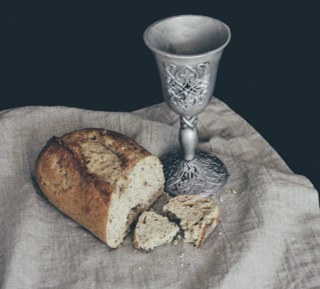
Communion
1 Corinthians 12:23-32

Slide 5
To God be the glory!

