Slide 1
Family Rules – Woe to those who would hurt God’s children
Matthew 18:5-9
Pastor Sam Kim
July 7, 2024

Slide 2


Scripture Reading
Family Rules –
Woe to those who would hurt God’s children
Matthew 18:5-8

Slide 3
God cares how his children are treated…..
Gen. 12:3 To Abraham: Bless those who bless, and curse for those who curse.
Disciples described in intimate language:
  Children of God ( John 1:12-13)
  The Body of Christ (1 Cor. 12)
  The Bride of Christ, w/ Jesus as Groom (Rev. 21)
  The Vine and the branches (John 15)

Slide 4
God cares about how his children are treated (cont.)
To Saul: “Why are you persecuting me? (Acts 9:4)
The Sheep & the Goats (Matt. 25)

Slide 5
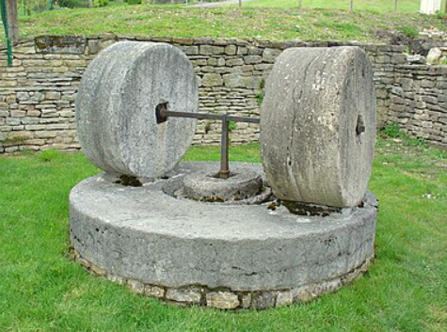
Woe to those who would hurt God’s children…
“Little one” =
Disciple of Christ
Cause to sin (skandalizo)
Better to have a millstone
tied to one's neck and
drowned in the sea
  Typical weight: 20 to +100 lbs.

Slide 6
Woe to those who would hurt God’s children (part 2)
“Woe” = judgment or curse
Zech 2:8 “Apple of God’s eye”
Personal to God: offending a believer = offending God
Goal: Hebrews 10:24-25
Not many should be teachers… (James 3:1)

Slide 7
Woe to those who would hurt God’s children (part 3)
Judgment on False Teachers or tolerating them (Rev. 2)
  Church in Pergamum – teaching of Balaam
  Church in Thyatira – teaching of Jezebel
Strong vs. Weak brothers – (Rom. 14 & 1 Cor. 8)
Parable of the Goats (Matt. 25:41-46)

Slide 8
Heed God’s warning: take drastic action if needed! (Matt. 18:8-9)
⁸ And if your hand or your foot causes you to sin, cut it off and throw it away. It is better for you to enter life crippled or lame than with two hands or two feet to be thrown into the eternal fire. ⁹ And if your eye causes you to sin, tear it out and throw it away. It is better for you to enter life with one eye than with two eyes to be thrown into the hell of fire.

Slide 9
To God be the glory!

