Slide 1
Welcome the Little Ones
Matthew 19:13-15
Pastor Sam Kim
August 18, 2024

Slide 2


Scripture Reading
Welcome the Little ones
Matthew 19:13-15

Slide 3
Est. fertility rate in 2024 by country
* Rate needed to maintain population is 2.1per 1000 women
** Est. World Population 2024 = 8,171M (Top 9 = 55%)
Rank Fertility | Country | Rate Fertility | Rank Population | Total
14 | Nigeria | 4.52 | 6 | 232
40 | Pakistan | 3.32 | 5 | 251
96 | Bangladesh | 2.07 | 8 | 173
101 | India | 2.03 | 1 | 1450
110 | Indonesia | 1.96 | 5 | 251
133 | United States | 1.84 | 3 | 345
151 | Brazil | 1.74 | 7 | 211
193 | China | 1.55 | 2 | 1419
199 | Russia | 1.52 | 9 | 144

Slide 4
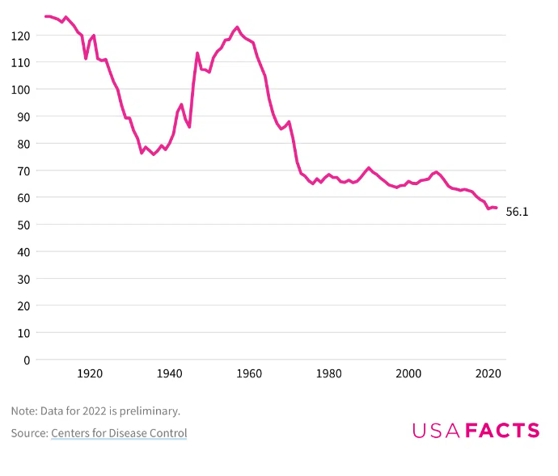
US Fertility Rates has mostly decreased since 1957
# of births per 1000 women

Slide 5
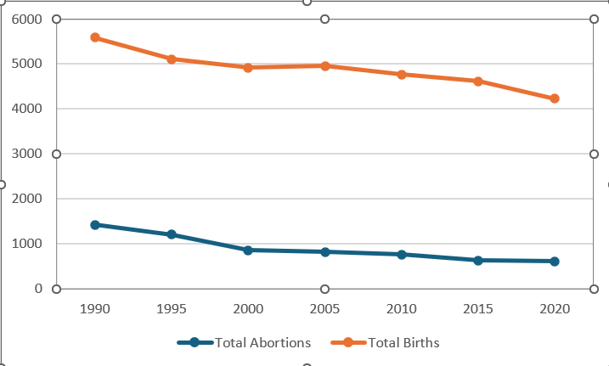
Total Births & Abortions every 5 years from 1990 to 2020

Slide 6
Matthew 19:13-15
¹³ Then children were brought to him that he might lay his hands on them and pray.
The disciples rebuked the people, ¹⁴ but Jesus said, “Let the little children come to me and do not hinder them, for to such belongs the kingdom of heaven.” ¹⁵ And he laid his hands on them and went away.

Slide 7
Theology of Deliverance by Babies in the Bible
Genesis 4 – For Adam & Eve/Infanticide
Genesis 12-21 – For Abraham/Promise
Exodus 1-2 Israel in slavery
1 Samuel 1-3 Dark time of the Judges
2 Kings 11 – Preserve the line of David
Matthew/Luke – Fulfillment of the Abrahamic and Davidic Covenants

Slide 8
In closing…
US between 1990-2020: 28M Abortions
The Churches Mission
  Take care of the little ones
  Take care of the “Spiritual little ones”
Keep the mindset of a “little one”– 1 Peter 2:2

Slide 9
To God be the glory!

