Slide 1
Equality in the Kingdom of God
Matthew 19:30 – 20:16
Pastor Sam Kim
September 29, 2024

Slide 2


Scripture Reading
Equality in the Kingdom of God
Matthew 19:30-20:16

Slide 3
3 key questions….
Who will be in the Kingdom of God?
Will there be a ranking in the Kingdom of God?
Will God be fair/just?

Slide 4
Interpretive keys to the Parable of the Laborers in the vineyard
It is about the Kingdom of heaven
Time references: typical workday 12 hrs.
Day laborers needed for seasonal work
God’s mandate: Lev. 19:13; Deut. 24:15
1 Denarius – daily wage for a Roman soldier
Owner: God the Father
Foreman: Jesus, the Son of God
Timeframe | Time |  | Timeframe | Time |  | Timeframe | Time
Early morning | ~ 6am |  | 6th hour | ~ Noon |  | 11th hour | ~ 5pm
3rd hour | ~ 9am |  | 9th hour | ~ 3pm |  | End of the Day | ~ 6pm

Slide 5
3 key questions….
Who will be in the Kingdom of God?
Will there be a ranking in the Kingdom of God?
Will God be fair/just?
Closing verses: Philippians 2:3-11

Slide 6
To God be the glory!

Slide 7
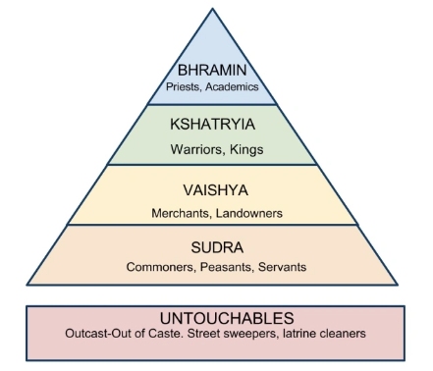
India Caste System

