Slide 1
Importance of the death & resurrection of Jesus
Matthew 20:17-19
Pastor Sam Kim
October 6, 2024

Slide 2


Scripture Reading
Importance of the death and resurrection of Jesus
Matthew 20:17-19

Slide 3
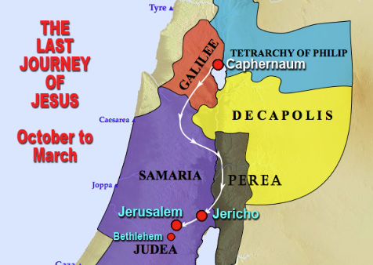
Dead Sea

Slide 4
Anti-type: Coming of Messiah –
His death & resurrection
4 Typologies (Foreshadowing):
God’s sacrifice of an animal to cover the nakedness of Adam/Eve (Genesis 3)
Abraham’s sacrifice of Isaac (Genesis 22)
Passover of the Angel of death in Egypt (Exodus 12)
Installation of the sacrificial system (Leviticus)

Slide 5
3 Prophesies told to the disciples
Prophecy | #1 Matt. 16:21 | #2 Matt. 17:22-23 | #3 Matt. 20:17-19
Location | Jerusalem |  | Jerusalem
Suffering | Many things | Delivered into: (Betrayal) | Mocked, flogged, betrayed Condemned (trial)
Perpetrators | Elders, Chief Priests, & Scribes | Betrayer to deliver over to men | Betrayer to deliver to: Chief Priests & Scribes Delivered to Gentiles
Death | Killed | Killed by men | By Crucifixion
Resurrection | 3rd Day | 3rd Day | 3rd Day

Slide 6
Prophesies concerning Jesus – O.T.
Zechariah 9-12
Psalm 22; 41:19; 69:21; 16:10
Isaiah 53 – The forbidden chapter

Slide 7
Meaning and Application
1 Peter 1:3-12 Meaning of the death & resurrection of Jesus
1 Peter 1:13-21 Call to holiness

Slide 8
To God be the glory!

