Slide 1
The King rejects Israel Matthew 21:12-22 Pastor Sam Kim November 10, 2024

Slide 2


Scripture Reading
The King Rejects Israel
Matthew 21:12-22

Slide 3
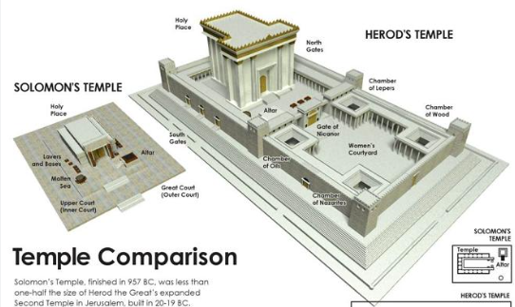

Slide 4
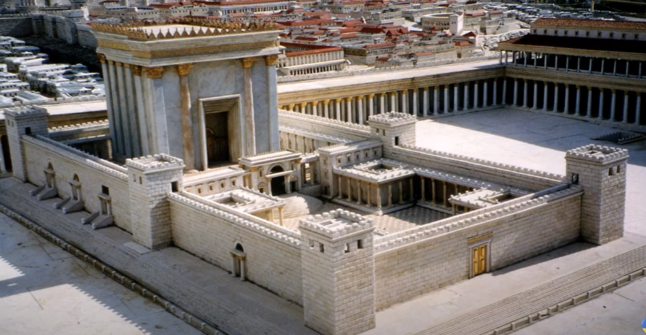

Slide 5
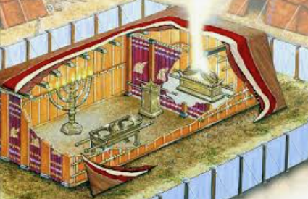

Slide 6
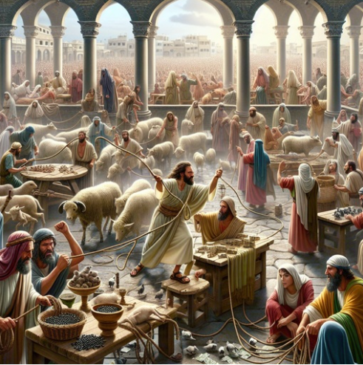

Slide 7
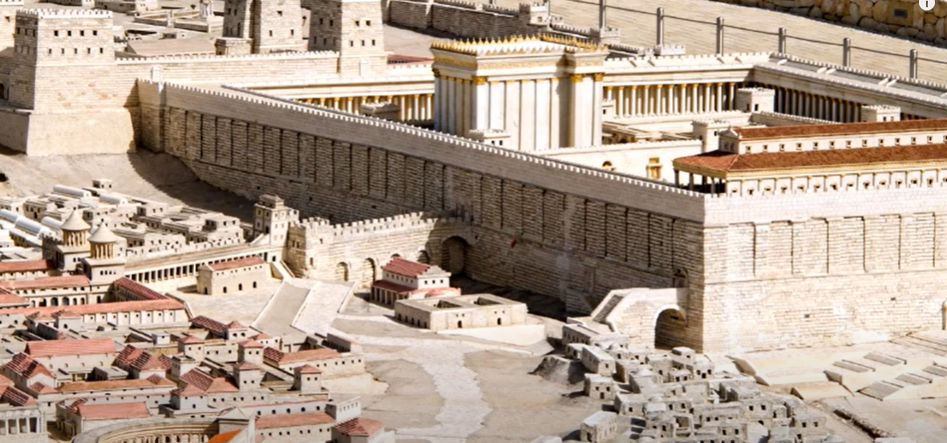

Western Wall… Wailing Wall

Slide 8
To God be the glory!

