Slide 1
Judgment on the Rulers of Israel
Matthew 21:33-46
Pastor Sam Kim
November 24, 2024

Slide 2


Scripture Reading
Judgment on the Rulers of Israel
Matthew 21:33-34
(Psalm 118:22-23)

Slide 3
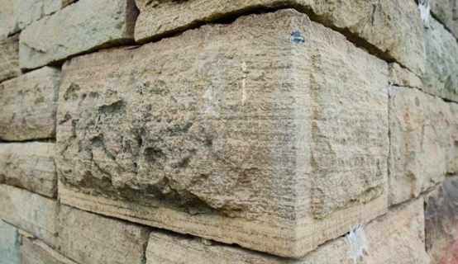
Jesus
Chief Cornerstone
Psalm 118:22-23
Acts 4:10-12
1 Peter 2:6-8

Slide 4
Interpretive keys…
Parable | True Meaning
Matthew 21:33-46
The Vineyard | The nation of Israel
Servants sent by the owner | O.T. Prophets (+John the Baptist) Luke 11:47-51
Tenant farmers | Rulers of Israel
The Son sent by owner | Jesus sent by the Father
Psalm 118:22-23
Rejected Cornerstone | Jesus at his first coming
New Cornerstone | Glorified Jesus after resurrection
Rejectors of the cornerstone | Rulers of Israel and all the enemies of Jesus

Slide 5
Key Take Aways…
Jesus gave the last prophetic word regarding his crucifixion by Israel
Judgment on the Rulers of Israel
God took away Israel’s prominence in the plan of salvation
All of Christ’s enemies will face judgment

Slide 6
To God be the glory!

