Slide 1
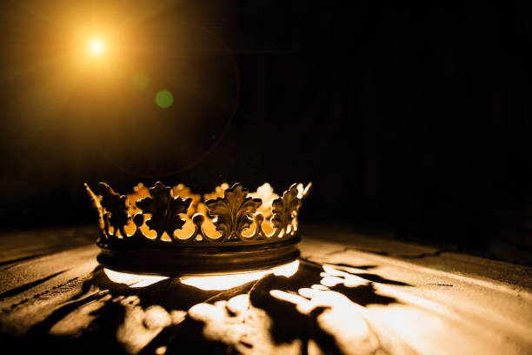
HEBREWS

Slide 2
“Jesus – Better Than All”
Hebrews 1:2-3

Slide 3
“[In this book] Christ is held up like a great jewel to the sunlight of God’s glory, and as the light courses through it, all the facets flash with gleaming brilliance.” R. Kent Hughes

Slide 5
I. Heir of All Things – (verse 2)

Slide 6
Romans 11:36
“For from him and through him and to him are all things. To him be glory forever. Amen.”

Slide 8
Ephesians 1:18
“…what are the riches of his glorious inheritance in the saints…”

Slide 10
II. Creator of All Things – (verse 2)

Slide 11
Colossians 1:16
“For by him all things were created, in heaven and on earth, visible and invisible, whether thrones or dominions or rulers or authorities—all things were created through him and for him.”

Slide 13
III. Glorious Over All Things – (verse 3)

Slide 14
“The Son does not reflect [God’s glory] as the moon does that of the sun, but is Himself the very beam of the divine brightness breaking into our dark world.” Hywel Jones

Slide 15
2 Corinthians 4:6
“For God, who said, ‘Let light shine out of darkness,’ has shone in our hearts to give the light of the knowledge of the glory of God in the face of Jesus Christ.”

Slide 17
Colossians 1:15
“He [Jesus] is the image of the invisible God…
Colossians 2:9
“For in him [Jesus] the whole fullness of deity dwells bodily”

Slide 19
IV. Sustainer of All Things – (verse 3)

Slide 20
Colossians 1:17
“And he is before all things, and in him all things hold together.”

Slide 22
“Surely if Christ upholds all things, He can uphold me. If the word of His power upholds earth and heaven, surely, that same word can uphold my poor trembling heart.” C.H. Spurgeon

Slide 24
V. Purifier of All His People – (verse 3)

Slide 25
Hebrews 9:12
“…he entered once for all into the holy places, not by means of the blood of goats and calves but by means of his own blood, thus securing an eternal redemption.”

Slide 26
“Nothing But the Blood”
For my pardon this I see:
nothing but the blood of Jesus.
For my cleansing this my plea:
nothing but the blood of Jesus.

Slide 28
Hebrews 10:11-12, 14
11 And every priest stands daily at his service, offering repeatedly the same sacrifices, which can never take away sins. 12 But when Christ had offered for all time a single sacrifice for sins, he sat down at the right hand of God… 14 For by a single offering he has perfected for all time those who are being sanctified.

Slide 29
“I do not – I cannot – for a moment admit that there is anything to be done by us to complete that work, or anything required of us to make the annihilation of our sins complete. Those for whom Christ died are cleansed from all their guilt, and they may go their way in peace. He was made a curse for us, and there is nothing but blessing left for us to enjoy.” C.H. Spurgeon

Slide 31
“Alas! And did my Savior Bleed”
Alas! And did my Savior bleed,
And did my Sovereign die!
Would he devote that sacred head
For sinners such as I!

Slide 32
“Alas! And did my Savior Bleed”
Was it for crimes that I had done
He groaned upon the tree!
Amazing pity! Grace Unknown!
And love beyond degree!

Slide 33
“Alas! And did my Savior Bleed”
Thus might I hide my blushing face
While his dear cross appears;
Dissolve my heart in thankfulness,
And melt mine eyes in tears.

Slide 35
“The writer is saying to those who were tired, worn out, and tempted to run back, ‘get your eyes off yourself and onto your Savior’…Get out of yourself and into Christ. Be absorbed with His love, His grace, His person, His work. Your hope is not in self but in Him.” David McWilliams

