Slide 1
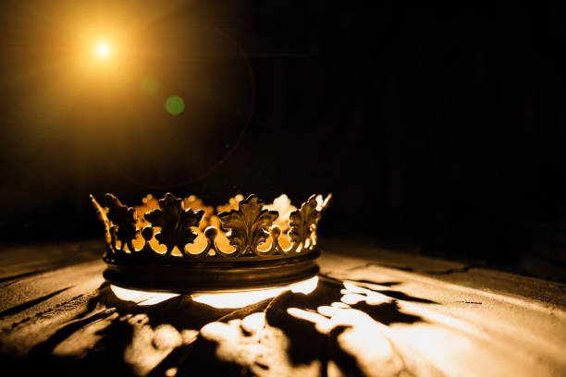
HEBREWS

Slide 2
“Jesus is Better than Angels”
Hebrews 1:4-14

Slide 3
“One of the benefits of this section of Hebrews is that we not only learn a great deal about angels, but, even more importantly, we learn a great deal about the glory of Christ.” Al Mohler

Slide 5
I. Son of God Rather than Angel From God (verses 4-5)

Slide 6
II. Worshiped Rather than Worshiper (verse 6)

Slide 7
Revelation 19:10
“You must not do that! I am a fellow servant with you and your brothers who hold to the testimony of Jesus. Worship God.”

Slide 9
Luke 2:13-14
“13 And suddenly there was with the angel a multitude of the heavenly host praising God and saying, 14 ‘Glory to God in the highest, and on earth peace among those with whom he is pleased!’”

Slide 11
“Is He Worthy”
Andrew Peterson
Is He worthy? Is He worthy?
Of all blessing and honor and glory
Is He worthy of this?
He is!

Slide 13
III. Creator Rather than Created
(verses 10-12)

Slide 14
“To the suffering Jewish believers who first heard these words, these sure words about Christ must have felt like refreshing rain. Their world was not only changing – it was falling apart. But their superior Christ remained the same – eternal and unchanging.” R. Kent Hughes

Slide 16
IV. King Rather than Servant
(verses 7-9, 13-14)

Slide 17
“Angels are but ministers and servants, who reveal or perform his will to those whom God sends them; they are honorable officers of the great King, fulfilling his pleasure, executing all his commands, and going and coming at his beck…Though they are bright, glorious, and excellent creatures, they are but the grand officers of state in heaven, encompassing God’s throne, waiting for his commands, which they obey and fulfill as swiftly as the winds or flashes or fire could dispatch them.” Matthew Poole

Slide 19
Psalm 91:11-12
11 For he will command his angels concerning you to guard you in all your ways. 12 On their hands they will bear you up, lest you strike your foot against a stone.

Slide 20
“[Angels] are always on duty, caring for the redeemed people of God according to his will…They look out for our safety, they undertake our defense, and they exercise a constant care.” Peter Holtvluwer

Slide 22
Luke 1:32-33
“32 He will be great and will be called the Son of the Most High. And the Lord God will give to him the throne of his father David, 33 and he will reign over the house of Jacob forever, and of his kingdom there will be no end.”

Slide 24
“Beware of the death of awe. Impress his greatness and majesty on your heart.” David McWilliams

Slide 25
“Is He Worthy”
Is He worthy? Is He worthy?
Of all blessing and honor and glory
Is He worthy of this?
He is!

