Slide 1
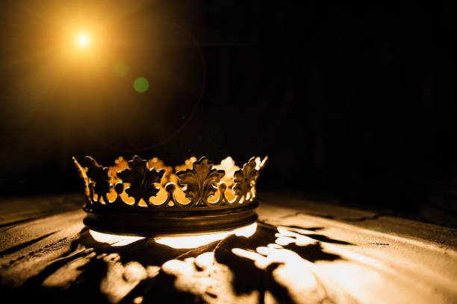
HEBREWS

Slide 2
“The Promise of a Better Country”
Hebrews 11:13-16

Slide 3
We Die Trusting in His Promise – (verse 13)

Slide 4
“Faith has a clear and strong eye, and can see promised mercies at a great distance…Faith has a long arm, and can lay hold of blessings at a great distance, can love them, and rejoice in them.” Matthew Henry

Slide 6
2 Corinthians 5:6-8
“6 So we are always of good courage. We know that while we are at home in the body we are away from the Lord, 7 for we walk by faith, not by sight. 8 Yes, we are of good courage, and we would rather be away from the body and at home with the Lord.”

Slide 8
“With the promises of God on our minds, we may well close our eyes in death with a song upon our lips.” C.H. Spurgeon

Slide 9
2 Timothy 4:18
“The Lord will rescue me from every evil deed and bring me safely into his heavenly kingdom. To him be the glory forever and ever. Amen.”

Slide 10
II. We Live Trusting in His Promise –
(verses 14-16)

Slide 11
John 14:1-3
“Let not your hearts be troubled. Believe in God; believe also in me. 2 In my Father’s house are many rooms. If it were not so, would I have told you that I go to prepare a place for you? 3 And if I go and prepare a place for you, I will come again and will take you to myself, that where I am you may be also.”

Slide 13
“True believers know nothing about going back. We are bound to go forward to the better land that is before us. Almighty grace will not permit the people of God to turn aside and find their rest anywhere else. We are bound for the Kingdom and, by the grace of God, we shall not rest until we enter it, to go out no more forever.” C.H. Spurgeon

Slide 14
1 Peter 1:3-5
“3…According to his great mercy, he has caused us to be born again to a living hope through the resurrection of Jesus Christ from the dead, 4 to an inheritance that is imperishable, undefiled, and unfading, kept in heaven for you, 5 who by God’s power are being guarded through faith for a salvation ready to be revealed in the last time.”

Slide 16
“We’re Almost Home”
Don't drop a single anchor, we're almost home
Through every toil and danger, we're almost home
How many pilgrim saints have before us gone?
No stopping now, we're almost home
That promised land is calling, we're almost home
And not a tear shall fall then, we′re almost home
Make ready now your souls for that kingdom come
No turning back we′re almost home

Slide 18
“We are God’s special possession… He takes special interest in us… As a Father he takes an interest in us that is the particular interest of a father in his children. A father may be interested in the children next door and other children down the street, and he may do many kindnesses to them. But that is not the relationship between father and child. That is very special, and that is God’s relationship to us – always watching over us, always with us, always caring for us.” Martyn Lloyd-Jones

Slide 20
“On Jordan’s Stormy Banks I Stand”
On Jordan's stormy banks I stand,
and cast a wishful eye
to Canaan's fair and happy land,
where my possessions lie.
O'er all those wide extended plains
shines one eternal day;
there God the Son forever reigns,
and scatters night away.

Slide 21
“On Jordan’s Stormy Banks I Stand”
No chilling winds or poisonous breath
can reach that healthful shore;
sickness and sorrow, pain and death,
are felt and feared no more.
When I shall reach that happy place,
I'll be forever blest,
for I shall see my Father's face,
and in his bosom rest.

Slide 22
“On Jordan’s Stormy Banks I Stand”
I am bound for the promised land,
I am bound for the promised land;
oh, who will come and go with me?
I am bound for the promised land.

