Slide 1
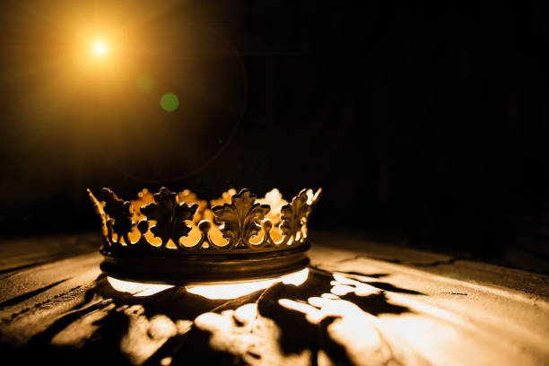
HEBREWS

Slide 2
“His Grace Be With Us All”
Hebrews 13:20-25

Slide 3
A Closing Exhortation – (verses 22-24)

Slide 4
Hebrews 12:1-2
“Therefore, since we are surrounded by so great a cloud of witnesses, let us also lay aside every weight, and sin which clings so closely, and let us run with endurance the race that is set before us, 2 looking to Jesus, the founder and perfecter of our faith, who for the joy that was set before him endured the cross, despising the shame, and is seated at the right hand of the throne of God.”

Slide 5
Hebrews 4:14
“Since then we have a great high priest who has passed through the heavens, Jesus, the Son of God, let us hold fast our confession.”
Hebrews 10:23
“Let us hold fast the confession of our hope without wavering, for he who promised is faithful.

Slide 7
“There is no letter in the New Testament that tells us more about Christ and his work…” Sinclair Ferguson

Slide 9
II. A Closing Benediction – (verses 20-21, 25)

Slide 10
“The price of our peace was the blood of Jesus, that is, the sacrifice of the incarnate Son on the cross. The proof of the acceptance of this sacrifice on our behalf is his resurrection from the grave and his exaltation to the right hand of the Majesty on high.” Philip Hughes

Slide 11
Hebrews 7:25
“Consequently, he is able to save to the uttermost those who draw near to God through him, since he always lives to make intercession for them.”

Slide 13
Hebrews 9:12, 15
“12…he entered once for all into the holy places, not by means of the blood of goats and calves but by means of his own blood, thus securing an eternal redemption…”
“15 Therefore he is the mediator of a new covenant, so that those who are called may receive the promised eternal inheritance…”

Slide 15
Hebrews 10:19, 22
“19…since we have confidence to enter the holy places by the blood of Jesus…
22…let us draw near with a true heart in full assurance of faith, with our hearts sprinkled clean from an evil conscience…”

Slide 17
John 10:27-30
“27 My sheep hear my voice, and I know them, and they follow me. 28 I give them eternal life, and they will never perish, and no one will snatch them out of my hand. 29 My Father, who has given them to me, is greater than all, and no one is able to snatch them out of the Father’s hand. 30 I and the Father are one.”

Slide 19
“We are enabled to do God’s will through God’s constant work of grace in our souls.” John Owen

Slide 21
Romans 11:36
“For from him and through him and to him are all things. To him be glory forever. Amen.”

Slide 23
“His grace is a stream of living water flowing through the desert, it is a power which enables us to withstand every adversity and guarantees that we will reach the promised land, the place of our rest, the heavenly Jerusalem.” Philip Hughes

Slide 25
“He Will Hold Me Fast”
When I fear my faith will fail
Christ will hold me fast
When the tempter would prevail
He will hold me fast
I could never keep my hold
Through life's fearful path
For my love is often cold
He must hold me fast

Slide 26
“He Will Hold Me Fast”
Those He saves are His delight
Christ will hold me fast
Precious in His holy sight
He will hold me fast
He'll not let my soul be lost
His promises shall last
Bought by Him at such a cost
He will hold me fast

