Slide 1
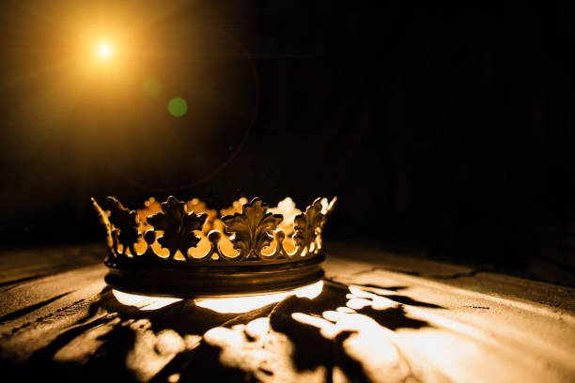
HEBREWS

Slide 2
“Jesus – The Better Conqueror”
Hebrews 2:14-15

Slide 3
How He Conquered – (verse 14a)

Slide 4
John 1:1, 14
“1 In the beginning was the Word [Jesus], and the Word was with God, and the Word was God.
14 And the Word became flesh and dwelt among us, and we have seen his glory, glory as of the only Son from the Father, full of grace and truth.”

Slide 6
“In Christ Alone”
In Christ alone who took on flesh
Fullness of God in helpless babe
This gift of love and righteousness
Scorned by the ones He came to save
Till on that cross as Jesus died
The wrath of God was satisfied
For every sin on Him was laid
Here in the death of Christ I live

Slide 7
“In Christ Alone”
There in the ground His body lay
Light of the world by darkness slain
Then bursting forth in glorious day
Up from the grave He rose again
And as He stands in victory
Sin's curse has lost its grip on me
For I am His and He is mine
Bought with the precious blood of Christ

Slide 8
II. What He Conquered - (verses 14b-15)

Slide 9
2 Timothy 1:10
“…and which now has been manifested through the appearing of our Savior Christ Jesus, who abolished death and brought life and immortality to light through the gospel…”

Slide 11
1 Corinthians 15:54-57
“54 When the perishable puts on the imperishable, and the mortal puts on immortality, then shall come to pass the saying that is written: “Death is swallowed up in victory.” 55 “O death, where is your victory? O death, where is your sting?” 56 The sting of death is sin, and the power of sin is the law. 57 But thanks be to God, who gives us the victory through our Lord Jesus Christ.”

Slide 13
Deuteronomy 32:29
“See now that I, even I, am he, and there is no god beside me; I kill and I make alive; I wound and I heal…”

Slide 15
“The devil is said to have the power of death, not because he can kill and destroy men at pleasure, but because he was the first introducer of sin, which brought death into the world, and so he was a murderer from the beginning; and he still tempts men to sin, and then accuses them of it, and terrifies and affrights them with the prospect of death as punishment…” John Gill

Slide 17
“Nothing more brings the mind into bondage than the fear of death.” Philo (Jewish Philosopher)

Slide 19
“The fear of death is endemic to the human race. It keeps dogging man’s steps whether he ignores it or turns and attempts to stare it down.” R. Kent Hughes

Slide 21
Ecclesiastes 7:2
“[Death] is the end of all mankind, and the living will lay it to heart.”

Slide 22
“To believers in Jesus, death is the messenger from our Father in heaven calling us home to Him.” C.H. Spurgeon

Slide 23
John 11:25-26
25 Jesus said, “I am the resurrection and the life. Whoever believes in me, though he die, yet shall he live, 26 and everyone who lives and believes in me shall never die. Do you believe this?”

Slide 24
“We spend our years with sighing; it is a valley of tears; but death is the funeral of all our sorrows.” Thomas Watson

Slide 26
Philippians 1:21
“For to me to live is Christ, and to die is gain.”

Slide 28
“Honesty compels us to admit that if the gospel is not true, then death is a horrifying reality we should fear. Death is the most frightening thing we can ever face without the gospel.” Al Mohler

Slide 29
“It is from this fear that Christ has released us, by undergoing our curse, and thus taking away what was fearful in death. Although we must still meet death, let us nevertheless be calm and serene in living and dying, for we have Christ going before us.” John Calvin

Slide 31
“Before the Throne of God Above”
When Satan tempts me to despair
and tells me of the guilt within,
upward I look and see him there
who made an end of all my sin.
Because the sinless Savior died,
my sinful soul is counted free;
for God the just is satisfied
to look on him and pardon me,
to look on him and pardon me.

Slide 32
“Before the Throne of God Above”
Behold him there, the risen Lamb,
my perfect, spotless righteousness,
the great unchangeable I AM,
the King of glory and of grace.
At one with him, I cannot die;
my soul is purchased by his blood.
My life is hid with Christ on high,
with Christ my Savior and my God,
with Christ my Savior and my God.

