Slide 1
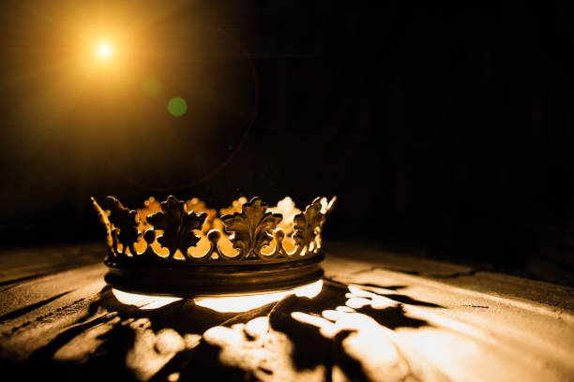
HEBREWS

Slide 2
“Jesus is Our Rest”
Hebrews 4:1-5

Slide 3
“Thou hast formed us for Thyself, O Lord, and our hearts are restless till they find rest in Thee.” Augustine

Slide 5
What is His Rest? – (verses 1-4)

Slide 6
Matthew 11:28-29
“28 Come to me, all who labor and are heavy laden, and I will give you rest. 29 Take my yoke upon you, and learn from me, for I am gentle and lowly in heart, and you will find rest for your souls.”

Slide 7
“[His rest] is a state of spiritual rest and deliverance from everything that was burdensome to the souls and consciences of believers.” John Owen

Slide 9
“It is Well With My Soul”
When peace like a river attendeth my way,
When sorrows like sea billows roll;
Whatever my lot Thou hast taught me to say,
It is well, it is well with my soul!

Slide 11
II. Who Enters His Rest? - (verses 2-5)

Slide 12
“As sure as the unbelieving Jews fell in the wilderness, and never reached the promised land, so sure it is that all unbelievers shall fall into destruction, and never reach heaven.” Matthew Henry

Slide 14
“God sends us this holy mixture of the hearing and believing, for our soul’s salvation and for His glory.” C.H. Spurgeon

Slide 16
“Salvation rest is living in God’s presence, feeling the warmth of his love, and trusting the strength of his hands to hold us forever.” Richard Phillips

Slide 18
“Jesus, I am Resting, Resting”
Jean Sophia Pigott
Jesus, I am resting, resting
in the joy of what thou art;
I am finding out the greatness
of thy loving heart.
Thou hast bid me gaze upon thee,
as thy beauty fills my soul,
for by thy transforming power,
thou hast made me whole.

Slide 19
“Jesus, I am Resting, Resting”
O how great thy lovingkindness,
vaster, broader than the sea!
O how marvelous thy goodness
lavished all on me!
Yes, I rest in thee, Beloved,
know what wealth of grace is thine,
know thy certainty of promise
and have made it mine.

Slide 20
“Jesus, I am Resting, Resting”
Simply trusting thee, Lord Jesus,
I behold thee as thou art,
and thy love, so pure, so changeless,
satisfies my heart;
satisfies its deepest longings,
meets, supplies its ev'ry need,
compasseth me round with blessings:
thine is love indeed.

Slide 21
“Jesus, I am Resting, Resting”
Ever lift thy face upon me
as I work and wait for thee;
resting 'neath thy smile, Lord Jesus,
earth's dark shadows flee.
Brightness of my Father's glory,
sunshine of my Father's face,
keep me ever trusting, resting,
fill me with thy grace.

Slide 22
“Jesus, I am Resting, Resting”
Jesus, I am resting, resting,
in the joy of what thou art;
I am finding out the greatness
of thy loving heart.

