Slide 1
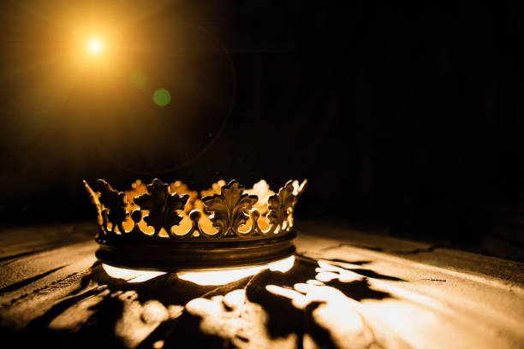
HEBREWS

Slide 2
“Jesus – Our Only Hope”
Hebrews 9:23-28

Slide 3
I. Our Past Hope – (verses 23-26)

Slide 4
Psalm 103:10,12
“10 He does not deal with us according to our sins, nor repay us according to our iniquities…12 as far as the east is from the west, so far does he remove our transgressions from us.”

Slide 5
Colossians 2:13-14
“13 … forgiven us all our trespasses, 14 by canceling the record of debt that stood against us with its legal demands. This he set aside, nailing it to the cross.”

Slide 7
“Christ does not put away sin through your tears, and your grief, and your merit, and your almsgiving. No, He put away sin by the sacrifice of Himself – nothing else… [Therefore] the only test as to whether Christ has put your sin away is this: Have you done away with all ideas of putting the sin away yourself.” C.H. Spurgeon

Slide 8
“Man of Sorrows”
Now my debt is paid
It is paid in full
By the precious blood
That my Jesus spilled

Slide 9
II. Our Present Hope – (verse 24)

Slide 10
Hebrews 7:25
“Consequently, he is able to save to the uttermost those who draw near to God through him, since he always lives to make intercession for them.”

Slide 12
1 John 2:1
“…But if anyone does sin, we have an advocate with the Father, Jesus Christ the righteous.”

Slide 14
Romans 8:1, 33-34
“1 There is therefore now no condemnation for those who are in Christ Jesus…
33 Who shall bring any charge against God’s elect? It is God who justifies. 34 Who is to condemn? Christ Jesus is the one who died—more than that, who was raised—who is at the right hand of God, who indeed is interceding for us.”

Slide 16
III. Our Future Hope – (verses 27-28)

Slide 17
Titus 2:13
“…waiting for our blessed hope, the appearing of the glory of our great God and Savior Jesus Christ…”

Slide 19
“We Will Feast in the House of Zion”
We will feast in the house of Zion
We will sing with our hearts restored
He has done great things, we will say together
We will feast and weep no more

Slide 21
“These three appearances of Christ are three skeins tightly woven into one unbreakable cord. That cord is one of love drawing His people homeward.” David McWilliams

