Slide 1
Parables of the Kingdom: Call to Action
Matthew 13:1-52
Pastor Sam
December 31, 2023

Slide 2


Scripture Reading
Parables of the Kingdom:
Call to Action
Matthew 13:51-52

Slide 3


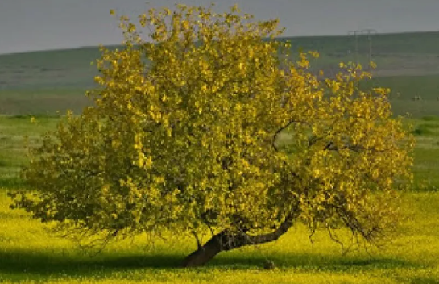


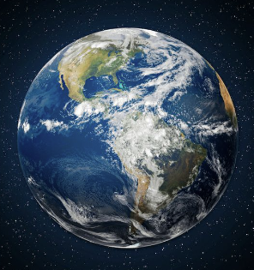
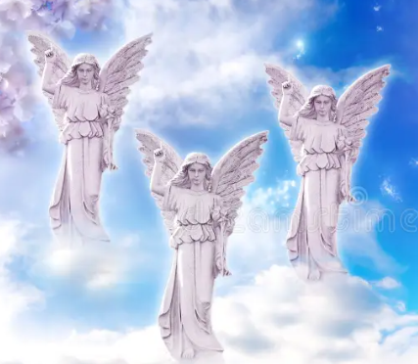
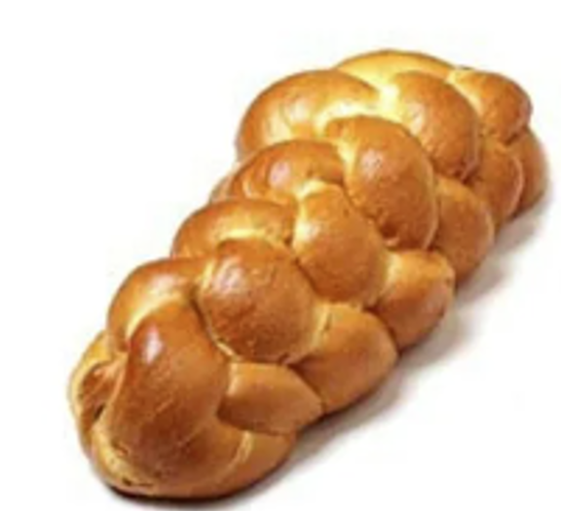
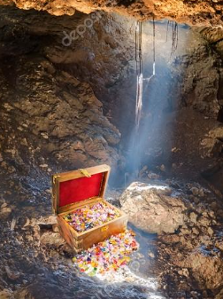

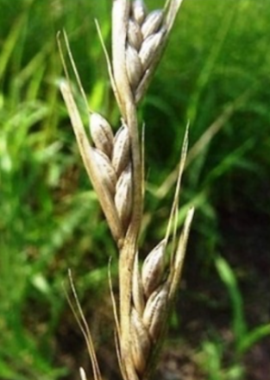
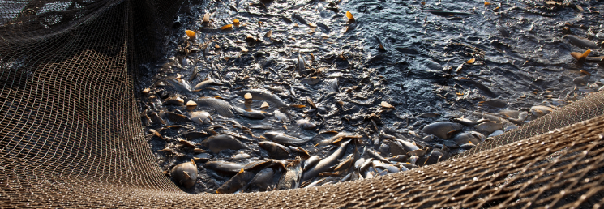


Parables of the Kingdom
Matthew 13
Heaven
Good
Shallow
Hell
THORNS
Hard

Slide 4
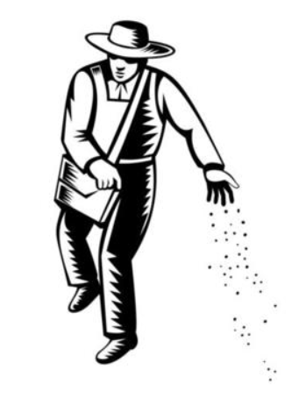




Call to Action…

Slide 5
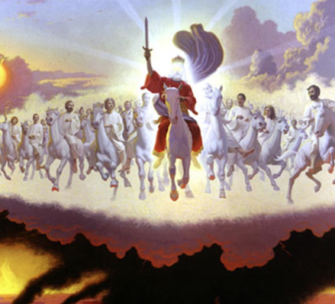


Two critical deadlines to consider…
End of Life
End of the Age

Slide 6
To God be the glory!

Slide 7
Call to Action…
To Seek 1st the Kingdom of God
To grow in our knowledge, understanding, and application of the Word of God.
To Sow the seeds of the Gospel to expand the Kingdom of God
To fight the battle of faith against the enemies of God.
To act with a sense of urgency, knowing that time is running out…..

