Slide 1
History is God’s Story
(Father - Son - Holy Spirit - Gen. 1:26)
Characters
Setting
Plot
Conflict
Resolution
(Every Story Has)

Slide 2
The King and His Eternal Unshakable Kingdom Story! Genesis 1 – Revelation 22

Slide 3
Creation
(Gen. 1-2)
Humanity
Intimacy
Family
Community
Authority
Creativity
Origin Identity Sexuality Meaning Morality Destiny

Slide 4
Corruption
(Gen. 3-5)
Sin
Guilt
Fear Gen. 3:15 (Satan)
Shame
Death
Curse Matt. 1:23
(Conflict of the Ages)

Slide 5
Covenants
(Gen. 6 - Mal.4)
Noah Gen. 9:8-17
Abraham Gen. 12:1-3
Moses Ex. 19:5-6
David 2 Sam. 7:12-17
New Covenant Jer. 31:31-14
300 Plus OT Prophetic Passages

Slide 6

Christ (Matt. 1-John 21) Birth John 1:14 Death 1 Pet. 3:18 Sin Canceled Rom. 6:23 Death Defeated Heb. 2:14 Satan Disarmed Col. 2:12 Curse Reversed Gal. 3:13-14 Resurrection Life John 5:23-24

Slide 7
Church
(Acts 1- Rev. 22)
People of God 1 Pet. 2:9-10 Mission of God Matt. 28:18-20 Spirit of God Acts 1:8 Gospel of God Rom. 1:16-17 Gifts of God Rom. 12:6-8
Make Disciples

Slide 8

Consummation
(Rev. 20-22)
Family Home Christ’s Return Worship Matt. 25:31-46 Joy Pleasures Judgment Partnership Rewards 1 Cor. 15:20-28

Slide 9
Remember:
History is God’s Story Acts 2:23
You are in His story Luke 19:10
Your story will end! Heb. 9:23
How it ends is up to you? Matt. 6:33

Slide 10
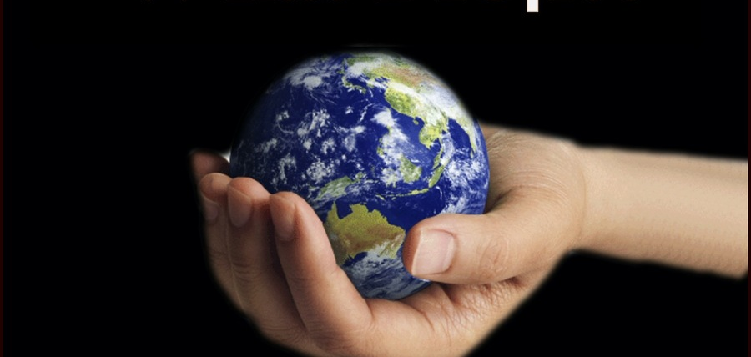
Seeing Beyond the Superficial!
(Ex. 2:23-25; Matt. 9:37-38)

Slide 11
1. A Burdened Heart!
“And the sons of Israel sighed because of the bondage, and they cried out; and their cry for help because of their bondage rose up to God. So, God heard their groaning; and God remembered His covenant with Abraham, Isaac, and Jacob. God saw the sons of Israel, and God took notice of them” Ex. 2:23
“Jesus our Empathetic Prince”
“Cultivate a habit of seeing people through God's eyes”

Slide 12
2. A Breaking Season!
“When Pharaoh heard of this matter, he tried to kill Moses. But Moses fled from the presence of Pharaoh and settled in the land of Midian, and he sat down by a well . . . Now Moses was pasturing the flock of Jethro his father-in-law, the priest of Midian” Ex. 2:15; 3:1
“When facing trials or challenges, resist the urge to rely solely on your own wisdom and strength”
“Jesus our Empathetic Prince”

Slide 13
3. A Wilderness of Preparation!
“Now the man Moses was very humble, more than any man who was on the face of the earth . . . . . Moses cried out to the Lord, saying, “O God, heal her, I pray. ” Number 12:1; 12:13
“Be content with weaknesses, with insults, with distresses . . . when you are weak you are strong”
“Jesus our Empathetic Prince”

Slide 14
4. An Encounter with God!
“He said also, “I am the God of your father, the God of Abraham, the God of Isaac, and the God of Jacob.” Then Moses hid his face, for he was afraid to look at God” Ex. 3:6
“Seek His presence, not just for answers but for
intimacy with Him”
“Jesus our Empathetic Prince”

Slide 15
6. A Courageous Faith in Action!
“By faith Moses, when he had grown up, refused to be called the son of Pharaoh’s daughter, choosing rather to endure ill-treatment with the people of God than to enjoy the passing pleasures of sin, considering the reproach of Christ greater riches than the treasures of Egypt; for he was looking to the reward” Heb. 11:24-26
Ex. 33:15-16
“Moses refused earthly positions, pleasures, treasures because he only feared the unseen God”
“Jesus our Empathetic Prince”

Slide 16
Breaking Through Superficiality
Cultivate a Deep Relationship with God Ps. 27:4
Love People with Genuine Compassion Mark 1:40-45
Sit at the feet of Jesus/tell people what you see Luke 10:38-42
“Stay on your knees, in His Word, sharing Christ by the
Power of the Holy Spirit for the Glory of God”
“Jesus our Empathetic Prince”

Slide 17
A Plea for Depth in a Superficial World
Let us see beyond the superficial, allowing our Lord to transform our hearts and lives for His purposes, so that by the power of the Holy Spirit, we can boldly reflect Christ and deliver His hope to a world in desperate need.
Matt. 6:9-13; John 17
“Jesus our Empathetic Prince”

